Slide 1



Great Datasets: A Story
Alex Cookson
@alexcookson
tacookson
_

Slide 2
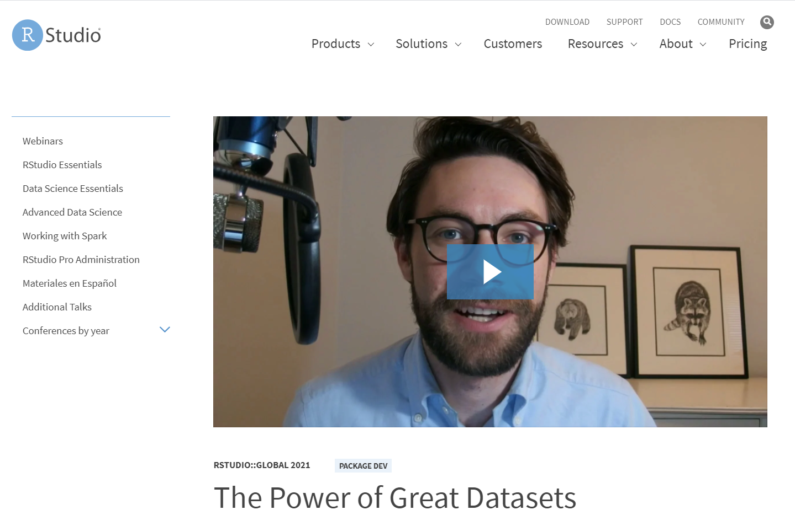
Bored? Busy?
Watch the 5-minute version of this talk

Slide 3
How do love stories usually go?

Slide 4
Non-binary person meets Boy
Non-binary person meets Girl
Girl meets Girl
Boy meets Girl
Girl meets Boy
Boy meets Boy
Non-binary person meets Non-binary person

Slide 5
Non-binary person meets Boy
Non-binary person meets Girl
Girl meets Girl
Boy meets Girl
Girl meets Boy
Boy meets Boy
Non-binary person meets Non-binary person
Learner meets Data

Slide 6
Ever seen a romantic comedy?
The Meeting
Sparks Fly
Tension / Crisis
Falling In Love

Slide 7

The Meeting: Hamilton
Hamilton tickets for Christmas!
My brother the Broadway fan
Weekly grosses: tickets sales, ticket prices, percent of seats sold – all the way back to 1985

Slide 8

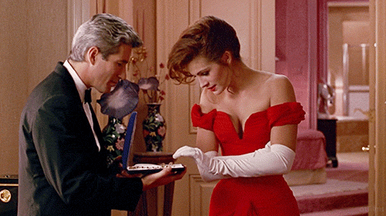
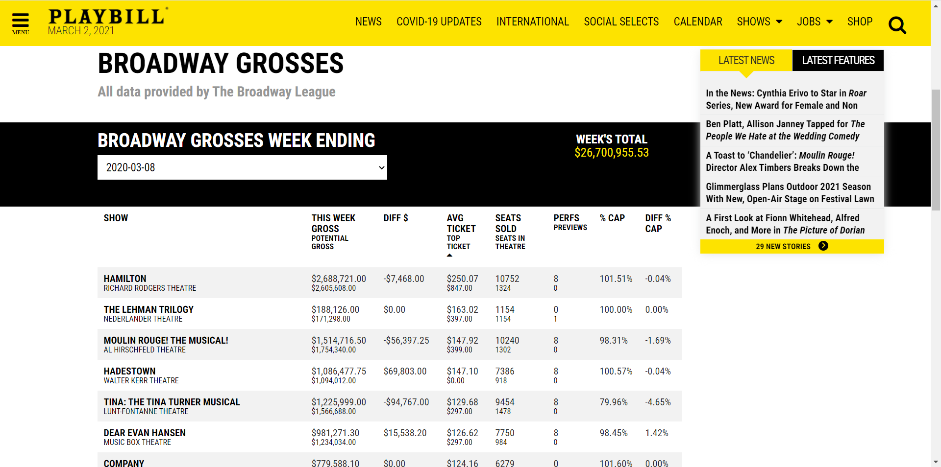
Sparks Fly: Weekly Grosses on Playbill

Slide 9
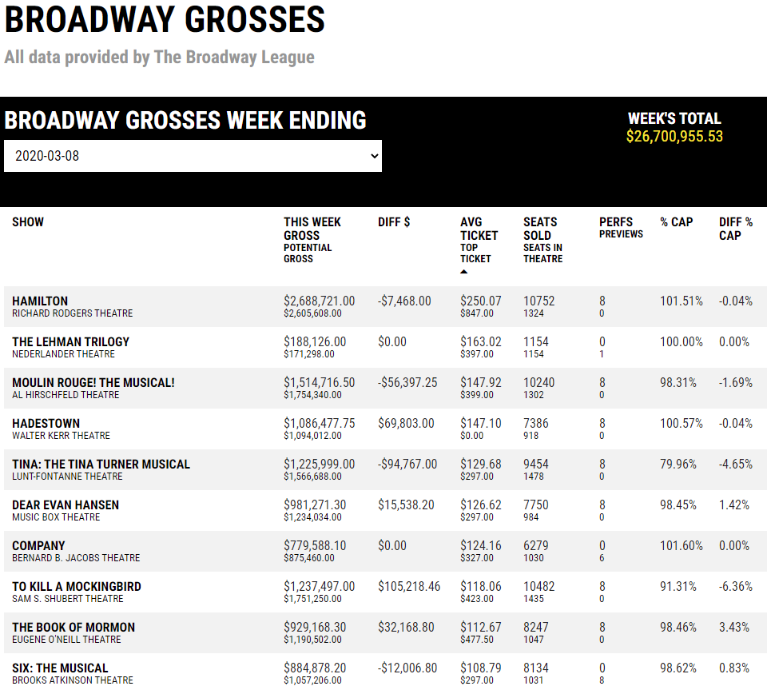

Slide 10
Are Hamilton tickets on Broadway really that expensive?

Slide 11
Yes! $250 (USD) a pop!
($850 if you’re fancy)

Slide 12
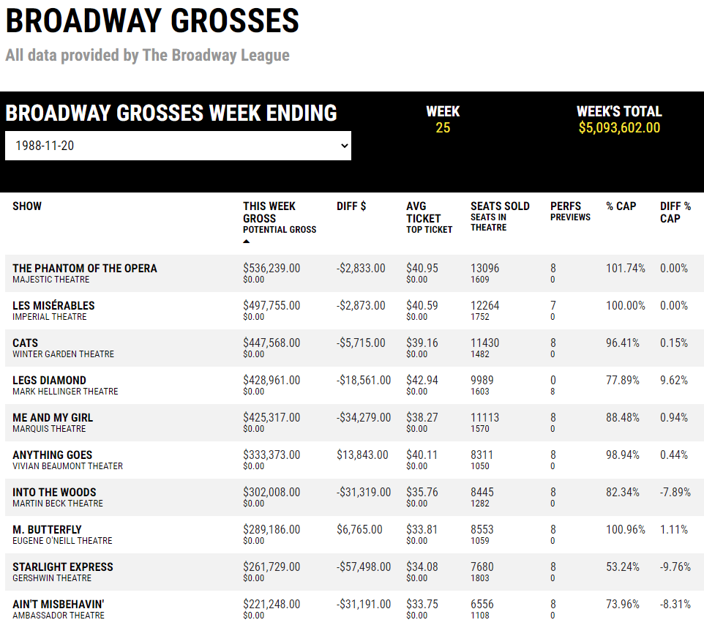
What was popular the week I was born?

Slide 13
Phantom, Les Mis, and Cats!

Slide 14
Is there any seasonality to ticket prices?
Is Hamilton’s success unprecedented?
Do revivals perform as well as their originals?
What’s the highest-grossing show EVER?
Have average ticket prices gotten more expensive?

Slide 15
Is there any seasonality to ticket prices?
???
Is Hamilton’s success unprecedented?
Do revivals perform as well as their originals?
What’s the highest-grossing show EVER?
Have average ticket prices gotten more expensive?

Slide 16

Tension / Crisis: Stuck!
I didn’t want data (one week at a time) – I wanted DATA (full dataset)
The data was right there, but I couldn’t get to it

Slide 17

Tension / Crisis: Stuck!
Should I learn how to web scrape?

Slide 18
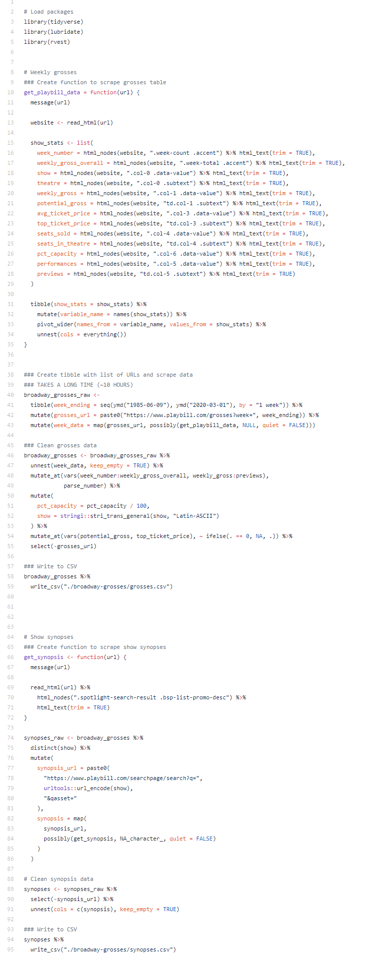
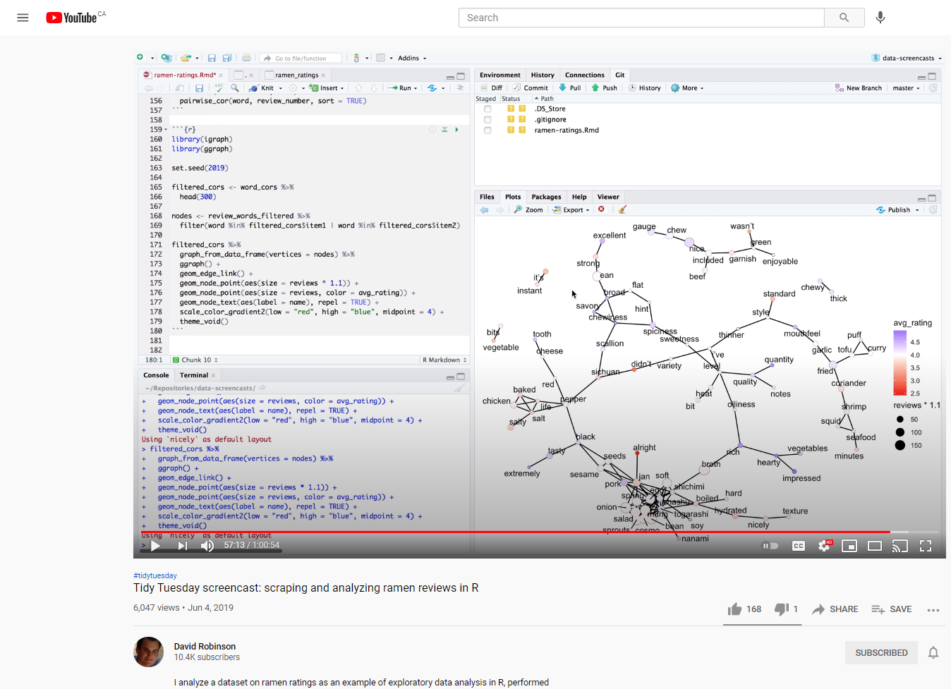

Tension / Crisis: Stuck!
+
=
David Robinson Screencast
Web scraping code
{rvest} package

Slide 19
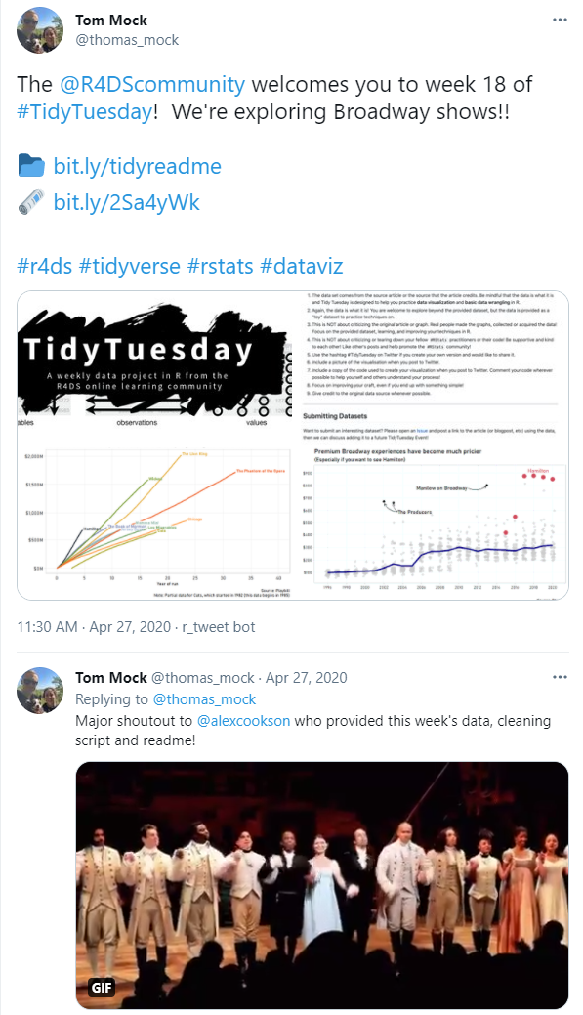
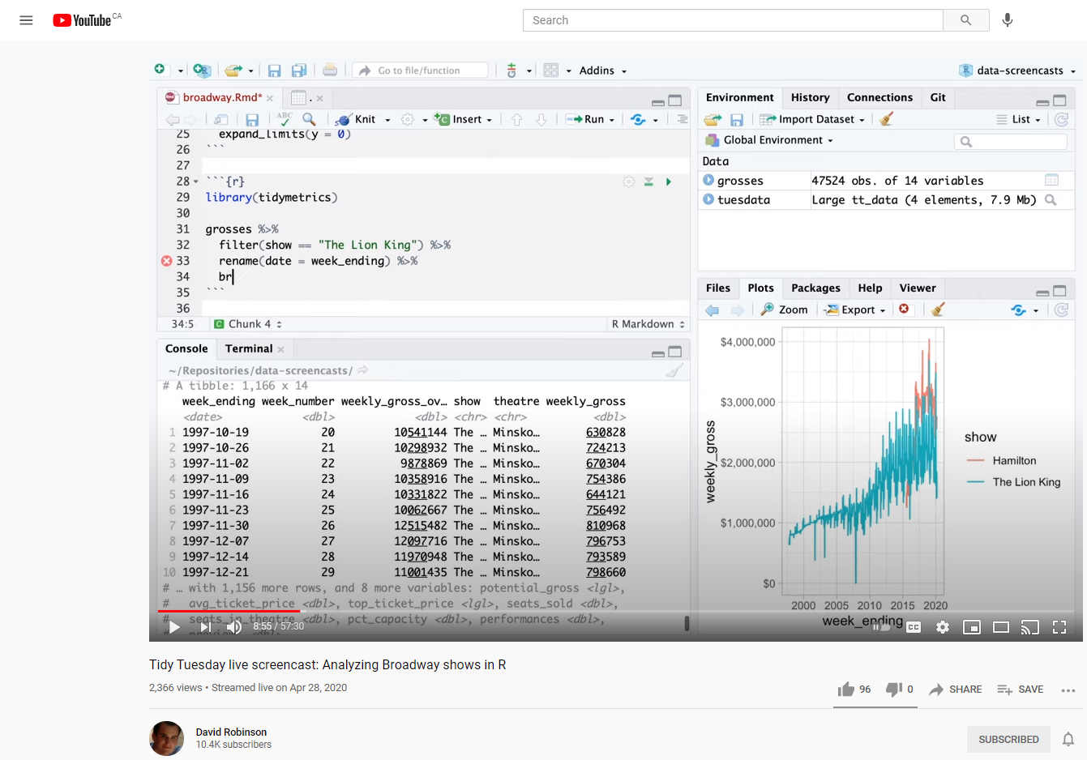

Falling In Love
Blog post
Another David Robinson screencast
Dataset featured on Tidy Tuesday

Slide 20
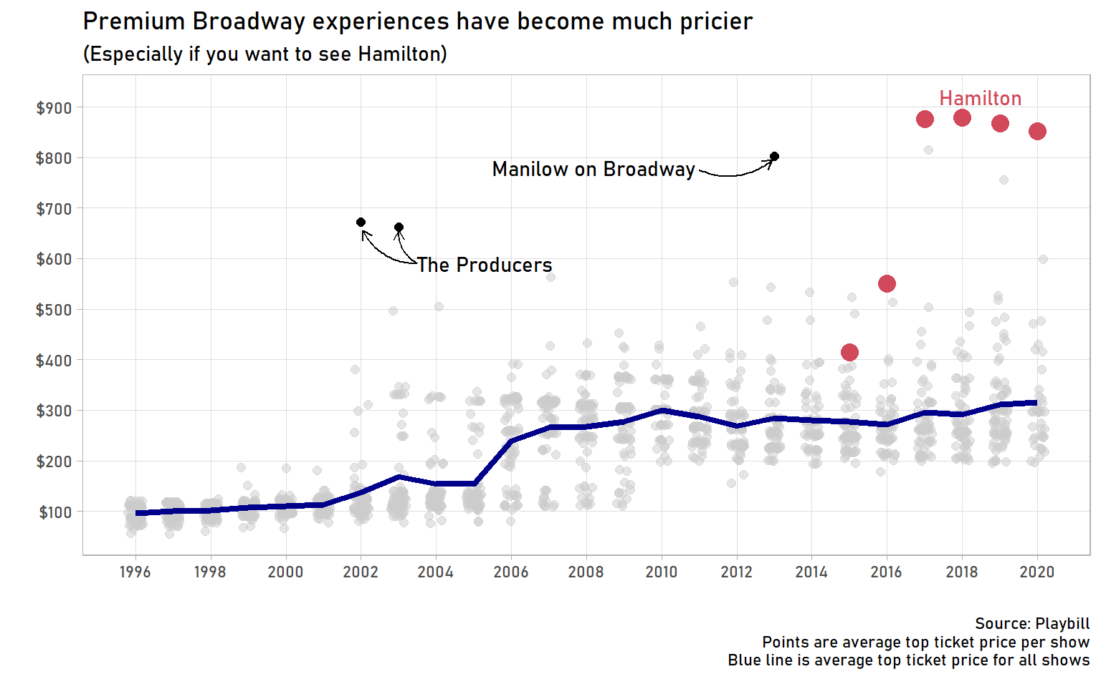
Falling In Love
Is Hamilton’s success unprecedented?

Slide 21
Falling In Love
No! The Producers was the Hamilton of its day

Slide 22
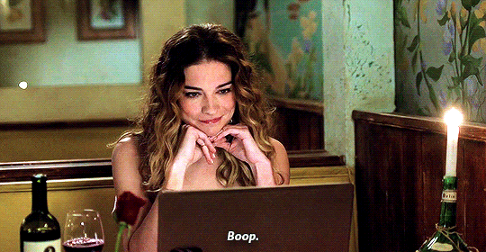
Falling In Love

Slide 23
Great Datasets: A Story
_

Slide 24
Great Datasets: A Story
—
—
^
ies
—
^
Many
_

Slide 25
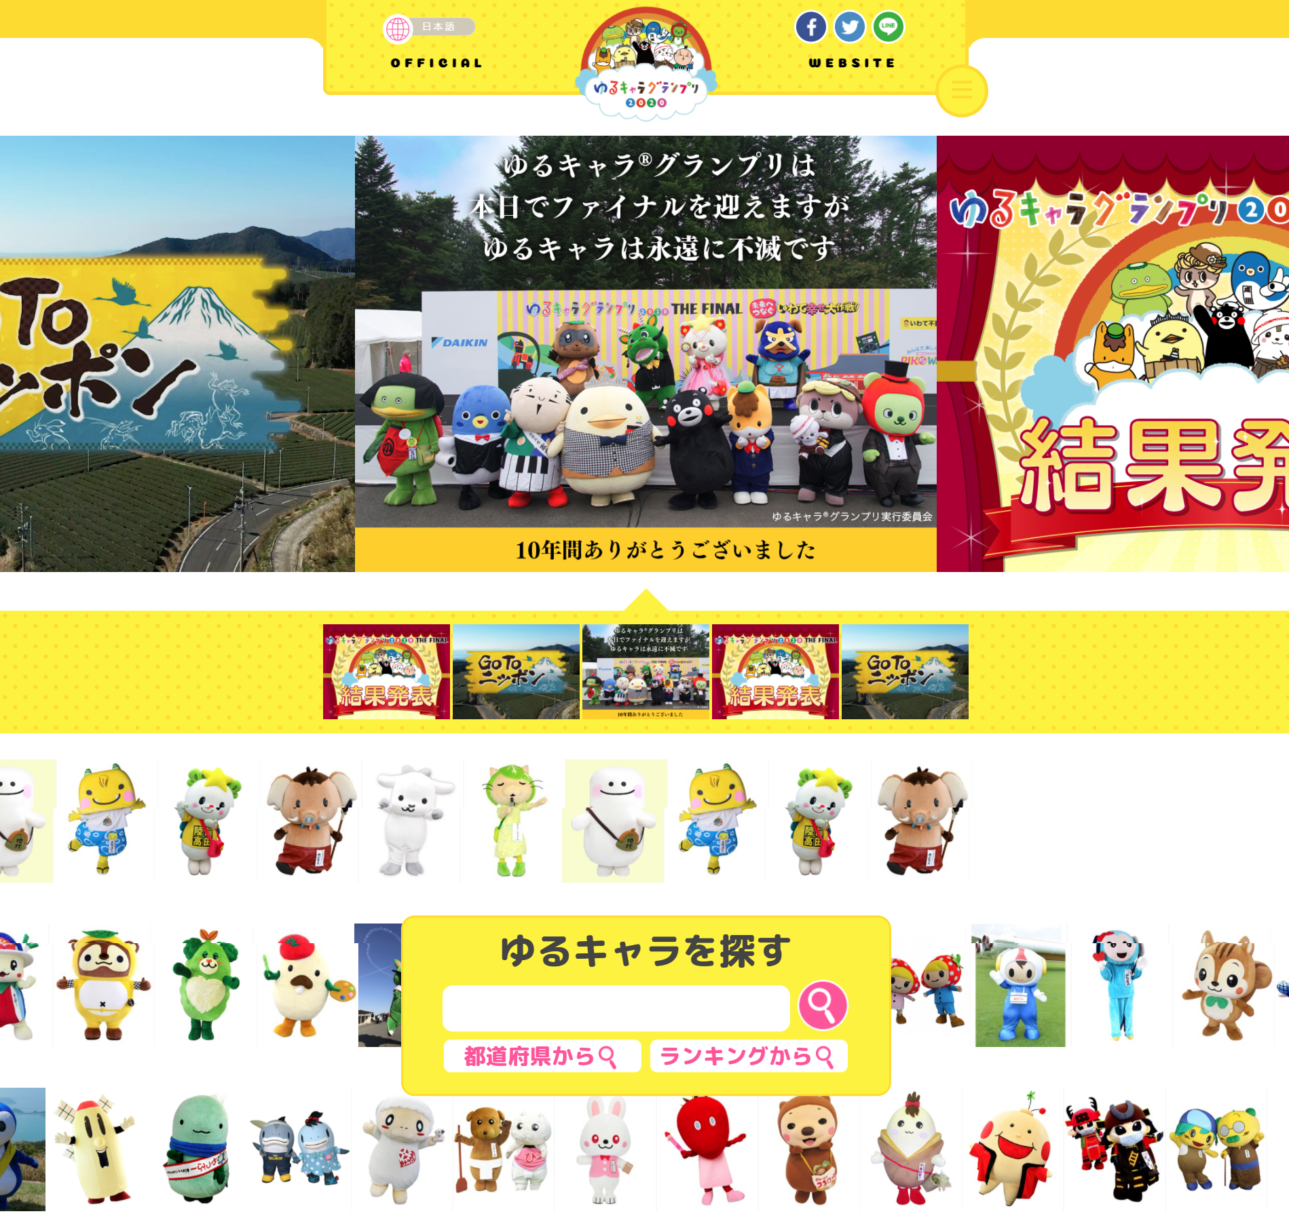
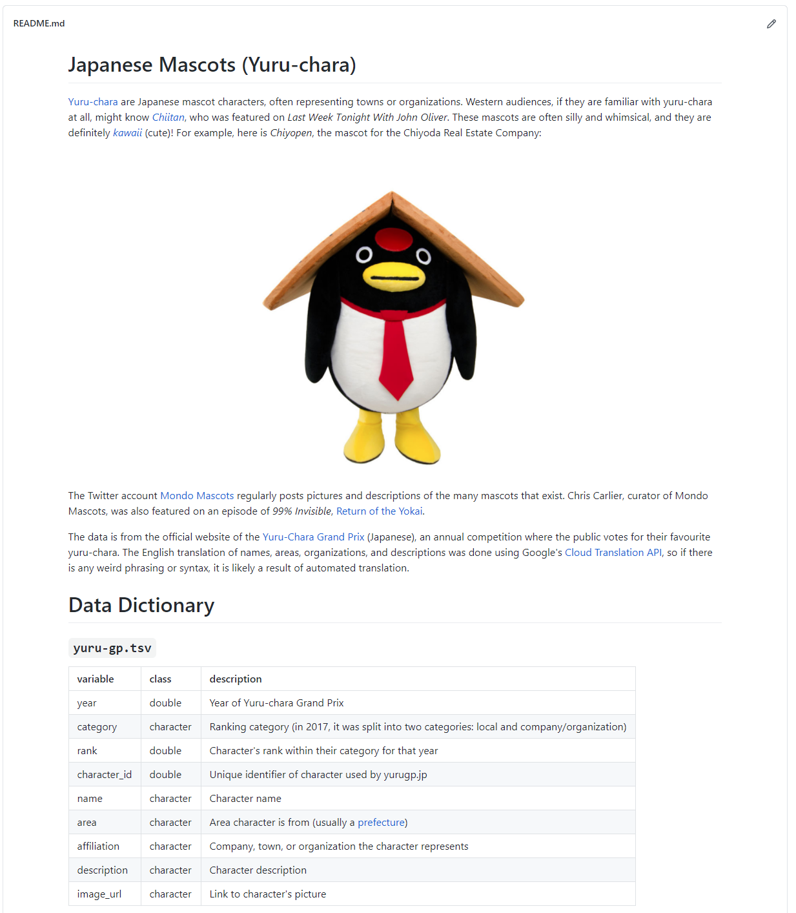
This Love Story kept repeating itself
More web scraping!
Using Google Language API with {googleLanguageR}

Slide 26
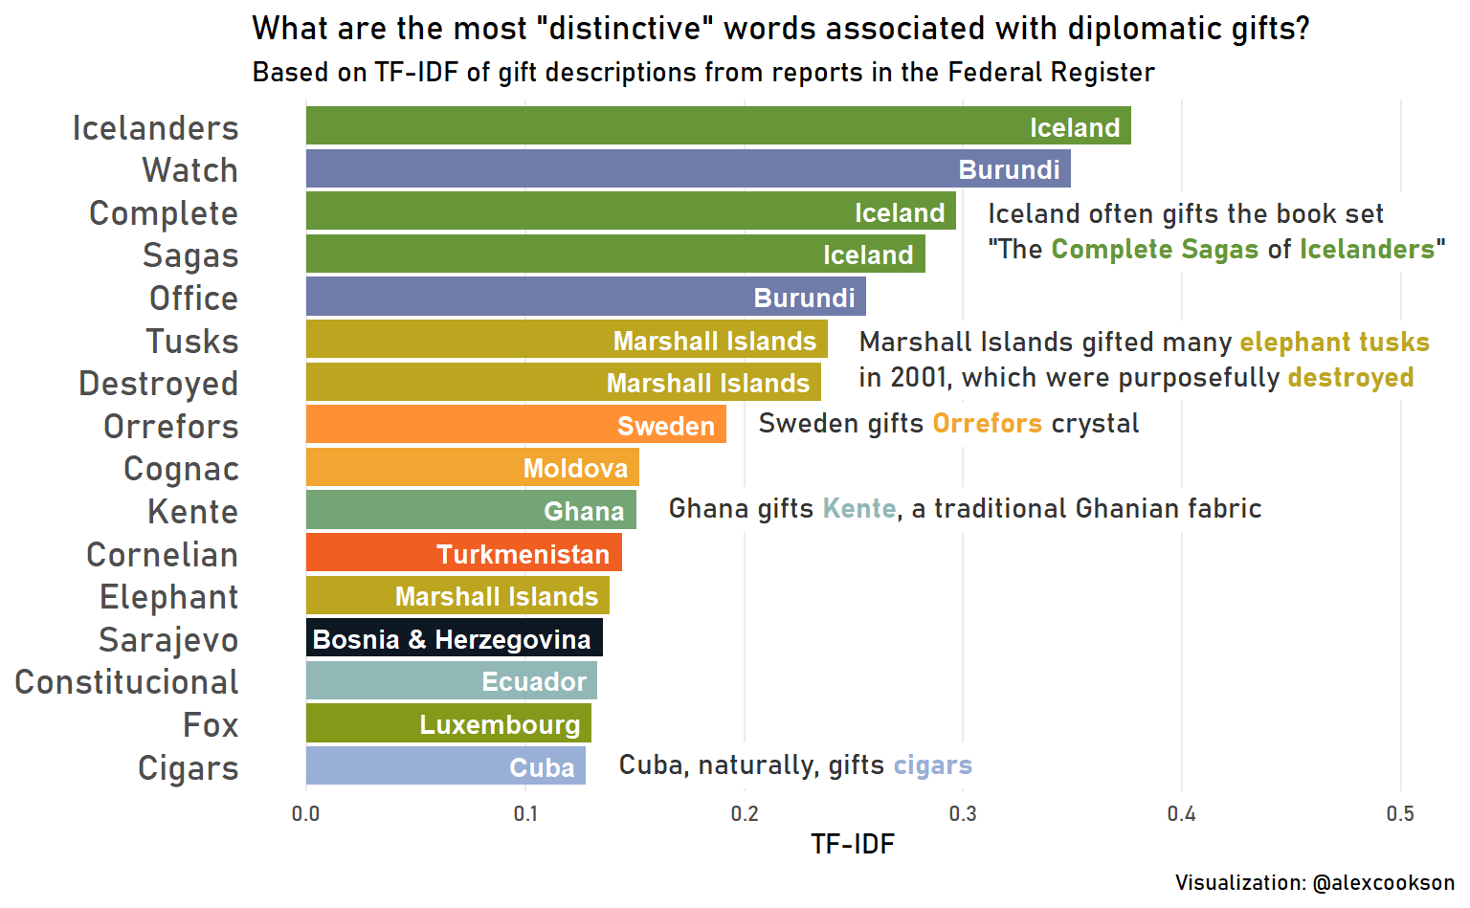
This Love Story kept repeating itself
Parsing dirty PDF data
Annotations and text formatting with {ggtext}
Basic Natural Language Processing (TF-IDF)

Slide 27
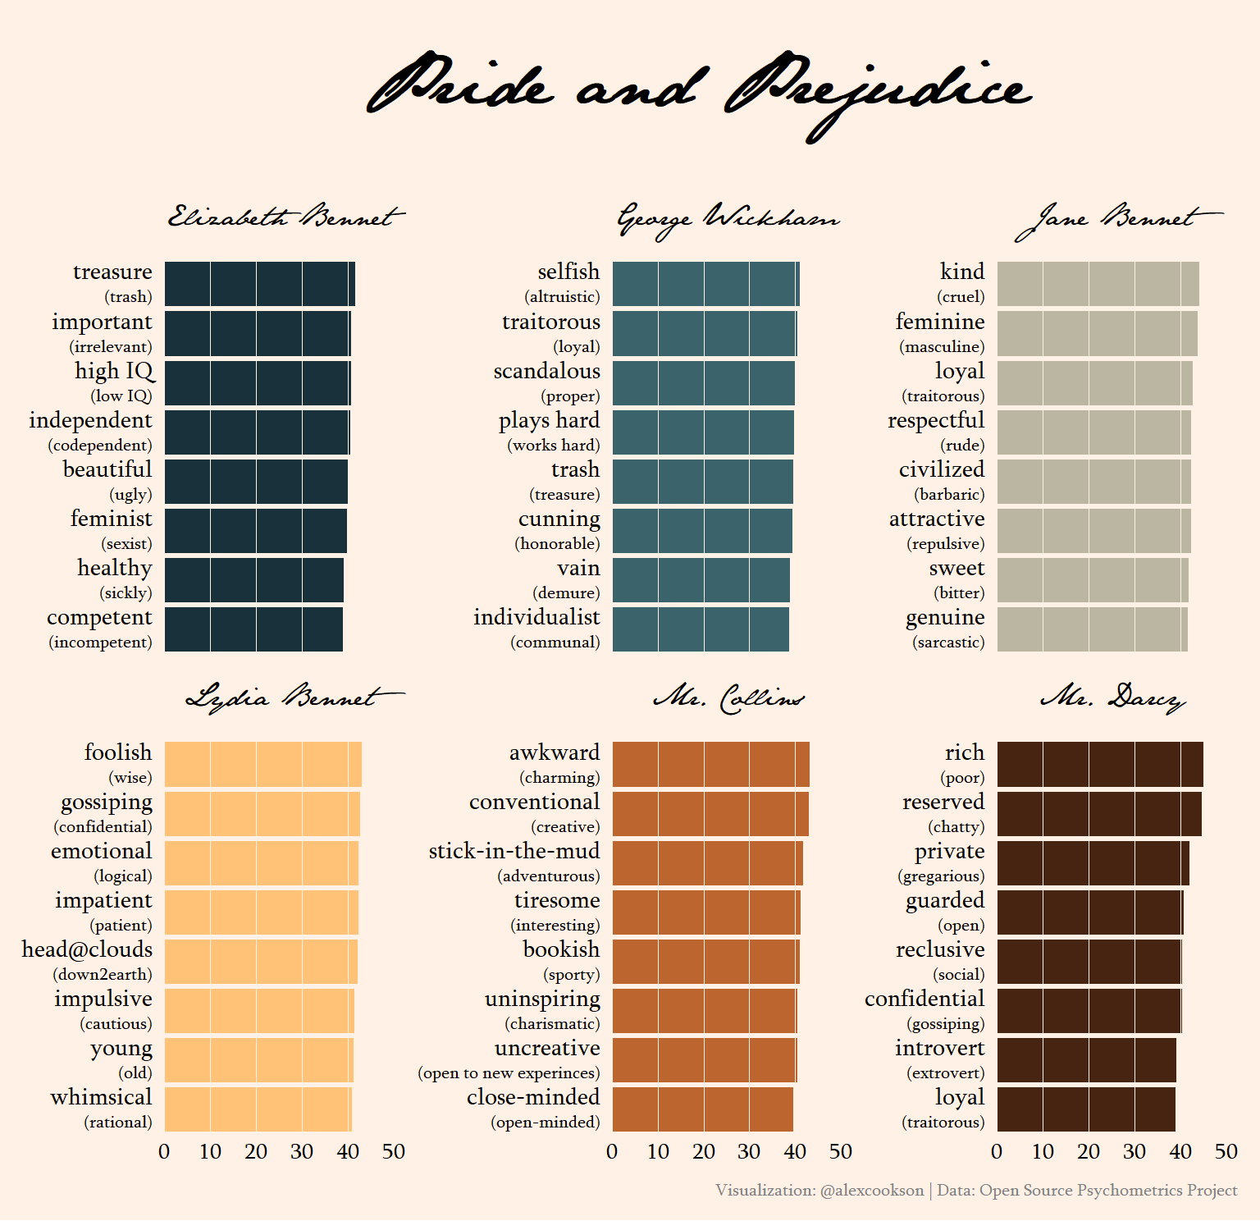
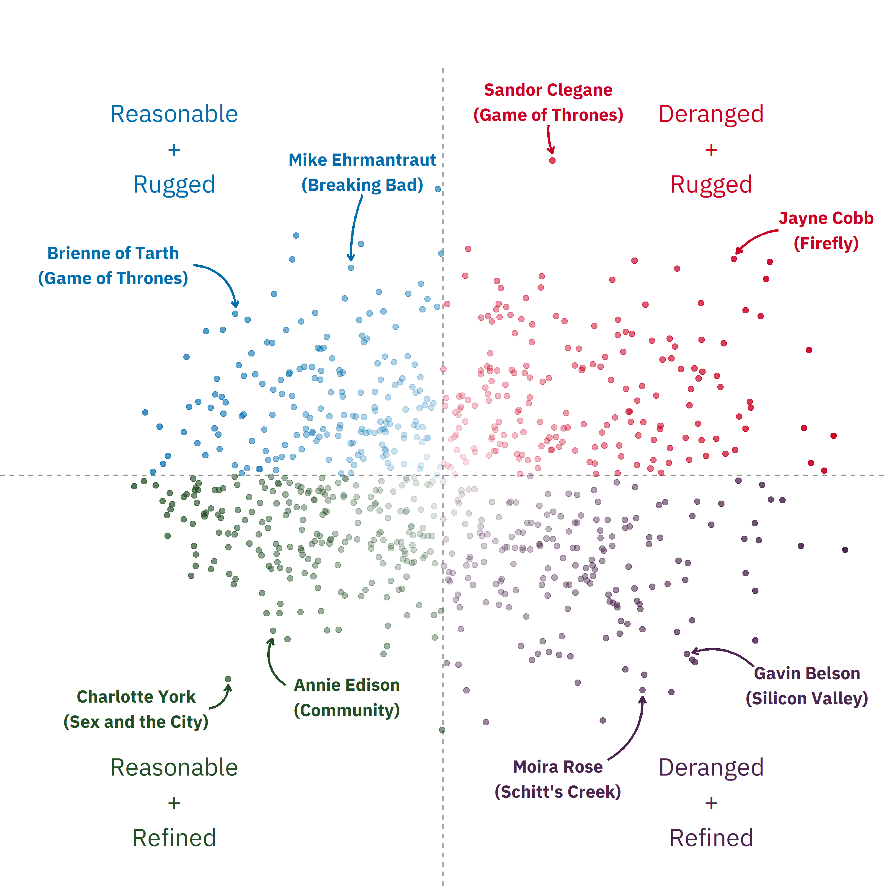
This Love Story kept repeating itself
More text formatting with {ggtext}
Principal Component Analysis (PCA)
Creating beautiful graphs with {ggplot2}
{tidymodels} framework
Interactive scatter plot with {plotly}

Slide 28
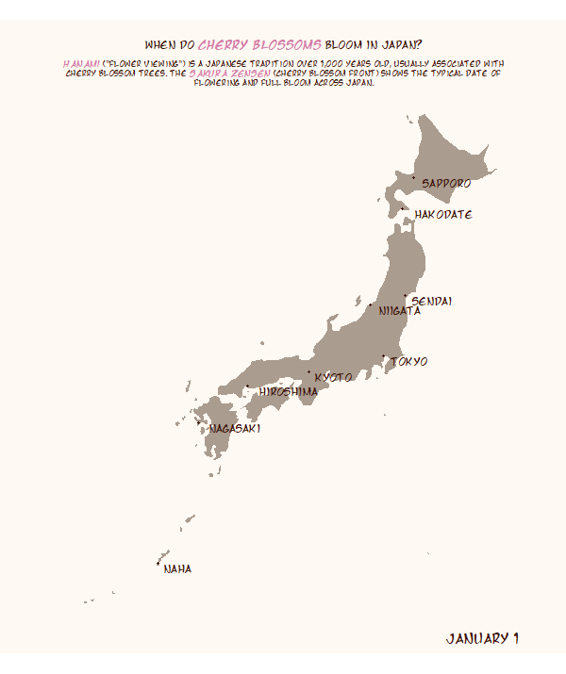
This Love Story kept repeating itself
So. Much. {gganimate}.
Text formatting with {ggtext}. Again.
Custom icons with {ggimage}
Installing and using custom fonts

Slide 29
The One Big Benefit (and Two Small Benefits) of Great Datasets

Slide 30
Great Datasets are… a Learning Path

Slide 31
Great Datasets are…a Learning Path
1. Decide what you want to learn
“I want to learn logistic regression”

Slide 32
Great Datasets are…a Learning Path
1. Decide what you want to learn
2. Find a dataset to practice on
“I want to learn logistic regression”
Titanic Passengers

Slide 33
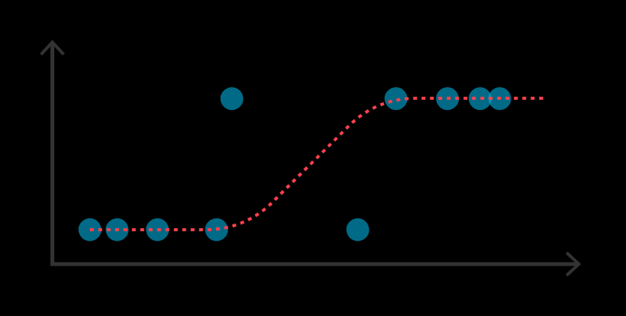
Great Datasets are…a Learning Path
1. Decide what you want to learn
2. Find a dataset to practice on
3. Achieve the outcome
“I want to learn logistic regression”
Titanic Passengers

Slide 34
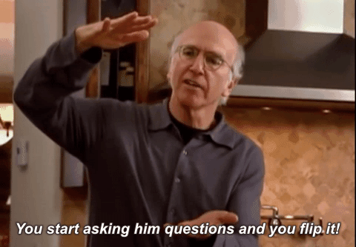
Flip it!

Slide 35
Great Datasets are…a Learning Path
1. Find a dataset that piques your curiosity
Broadway Grosses

Slide 36
Great Datasets are…a Learning Path
1. Find a dataset that piques your curiosity
2. Let your curiosity
guide you
What questions do I have for this data?
Broadway Grosses

Slide 37
Great Datasets are…a Learning Path
1. Find a dataset that piques your curiosity
2. Let your curiosity
guide you
3. Learn something as a by-product
Web scraping?
Time-series analysis?
Forecasting?
NLP?
Causal inference?
What questions do I have for this data?
Broadway Grosses

Slide 38
Great Datasets are…a Learning Path
Focus on this…
1. Find a dataset that piques your curiosity
2. Let your curiosity
guide you
3. Learn something as a by-product
Web scraping?
Time-series analysis?
Forecasting?
NLP?
Causal inference?
What questions do I have for this data?
Broadway Grosses

Slide 39
Great Datasets are…a Learning Path
Focus on this…
…not this
1. Find a dataset that piques your curiosity
2. Let your curiosity
guide you
3. Learn something as a by-product
Web scraping?
Time-series analysis?
Forecasting?
NLP?
Causal inference?
What questions do I have for this data?
Broadway Grosses

Slide 40
Great Datasets are… Sharing who you are

Slide 41
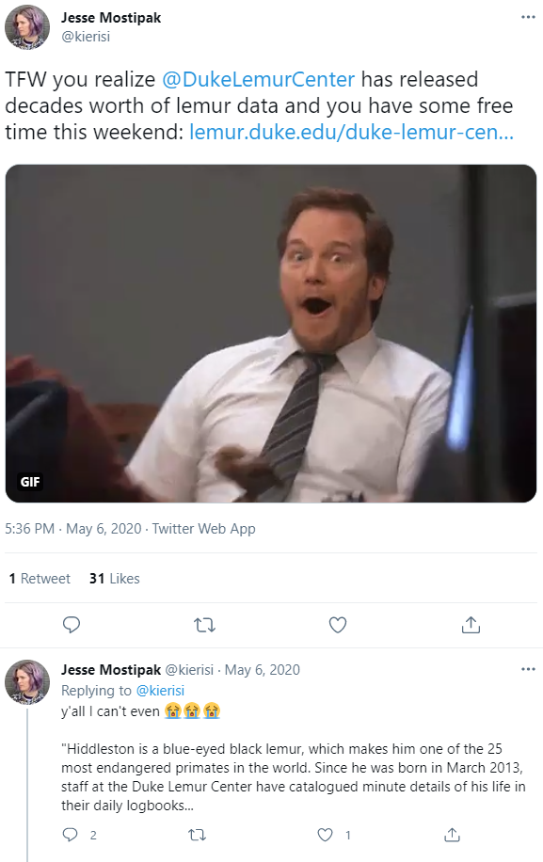
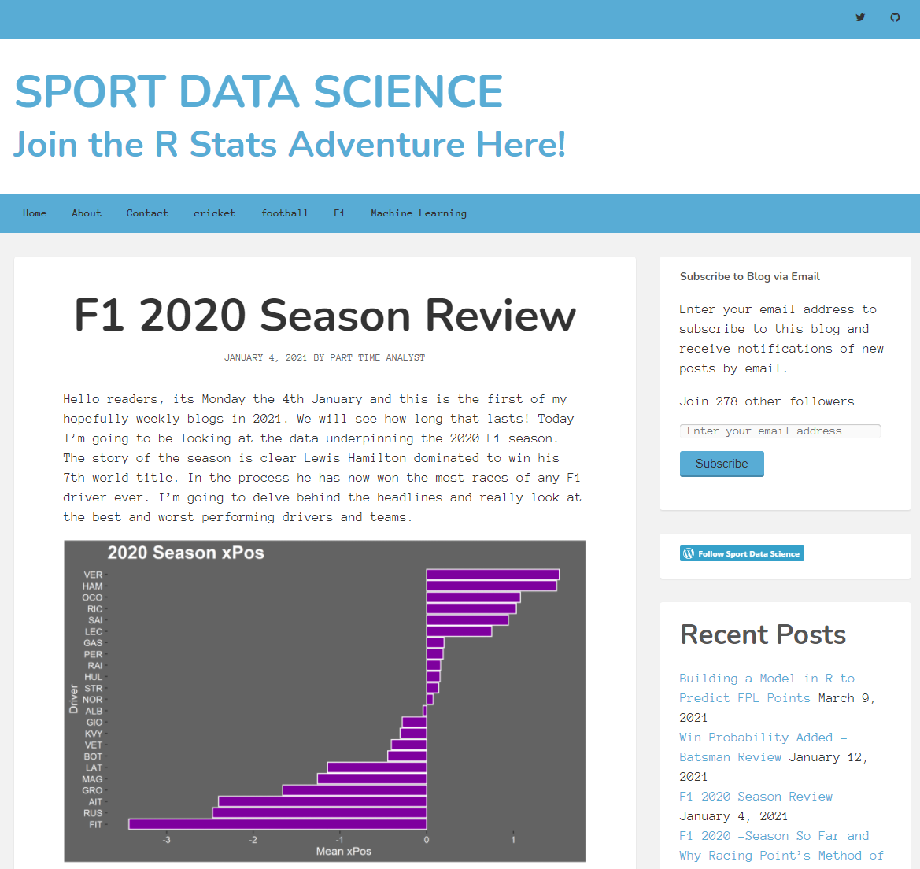
Great Datasets are…Sharing who you are

Slide 42
Great Datasets are… Community-builders

Slide 43

Great Datasets are…Community-builders
Me when someone likes a tweet about a dataset I shared
If you like a dataset…so does someone else
More (and more diverse) datasets enrich the community
Curating and sharing datasets is a way for you to engage with the community

Slide 44
Okay Alex, I’m convinced!
How do I start?

Slide 45
Getting Going with Great Datasets
Start with existing datasets (TidyTuesday, Kaggle, my data repository)
Don’t force it – know your interests and be watchful
Know that curating your own datasets will probably involve web scraping
Share! Encouragement from others is a great motivator

Slide 46
Great Datasets: A Story
Alex Cookson
@alexcookson
tacookson
_

